Slide 1
General and Generalized Linear Models in R
MARS 5470 Intro to Scientific Computing Guest Lecture – 31 Oct 2019
Dr. Chris Gabler Assistant Professor, SEEMS & Biology, UTRGV

Slide 2
What am I talking about?
https://tinyurl.com/y6zy4wdb
Linear modeling ← You are hear
General linear models (LM)
Beyond simple regression, multiple regression
Basic ANOVA
Logistic regression
Non-linear functions using OLS (ordinary least squares)
Generalized linear models
Non-normal distribution families (GLM)
Zero-inflation and over-dispersion
Random effects and mixed models (LME and GLME)

Slide 3
Model Selection

Slide 4
What governs which test is most appropriate?
The types of variables under consideration
The data structure of relevant variables
Two potential roles for each variable:
Independent = explanatory = predictor variables
You sometimes control this; it’s what you think matters.
Dependent = outcome = response variables
You never control this; it’s what you think gets affected.
This mainly pertains to hypothesis testing. The rationale for certain modeling or simulation approaches is different and can be more nuanced.

Slide 5
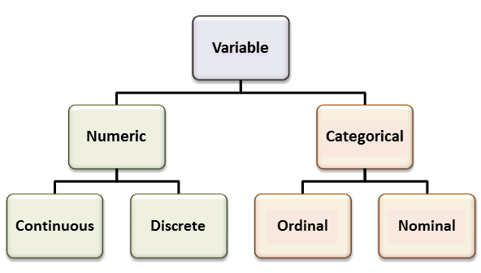
Variable types

Slide 6
Variable types
Numeric (aka interval) variables are quantitative
Continuous: can be any value within a theoretical range of values
Height, weight, time, distance, reflectance, etc.
Discrete: can only be whole units (integers); typically count data
Number of individuals, abundance of behavioral events, etc.
Categorical variables are qualitative
Nominal: one of several categories; distinct, but can be arbitrary
Gender, class, treatment group, method used, etc.
Includes binary data; e.g., live/dead, present/absent, pass/fail, etc.
Ordinal: basically nominal, but where the possible values are ordered; “in-between” categorical and quantitative
Distance between categories is not uniform
Education level, developmental stage, cancer stage, etc.
Rank is most common, and is used as a solution to non-normality

Slide 7
Specific tests are best for certain combinations of variable types.
https://stats.idre.ucla.edu/other/mult-pkg/whatstat/

Slide 8
The Core Four Analyses
Response Variable | Predictor Variable
 | Categorical | Continuous
Categorical | Chi-squared test | Logistic regression*
Continuous | ANOVA* | Regression*
*Linear model family

Slide 9
Regression

Slide 10
Start by finding best-fit lines
Equation for a line:
y = mx + b
y = (slope) * x + (intercept)
Equation for slope:
m = rise / run
m = r * (sy / sx)
slope = (Pearson’s correlation coefficient) * [(std dev of y) / (std dev of x)]
Equation for y-intercept:
b = y – bx
Intercept = (mean of y sample) – (slope) * (mean of x sample)

Slide 11
Alternatively
y’ = a + bx
a = (Σy)(Σx²) – (Σx)(Σxy)
n(Σx²) – (Σx)²
b = n(Σxy) – (Σx)(Σy)
n(Σx²) – (Σx)²

Slide 12
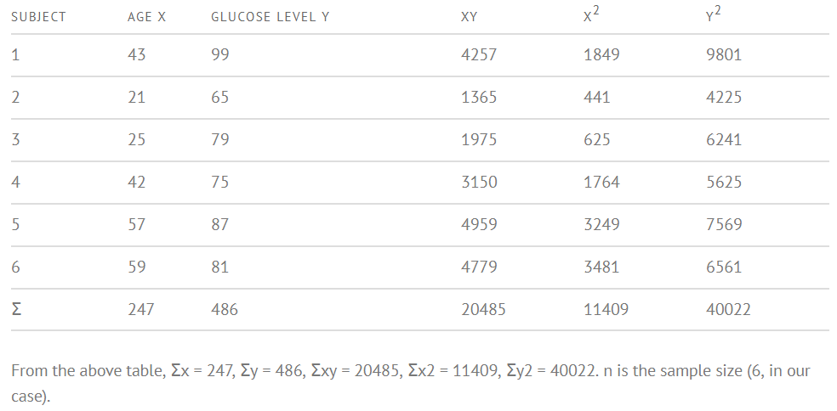
Crunch numbers

Slide 13
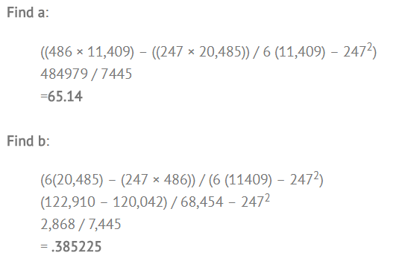
Crunch numbers
y’ = a + bx
a = (Σy)(Σx²) – (Σx)(Σxy)
n(Σx²) – (Σx)²
b = n(Σxy) – (Σx)(Σy)
n(Σx²) – (Σx)²
y’ = 65.14 + 0.385225x

Slide 14
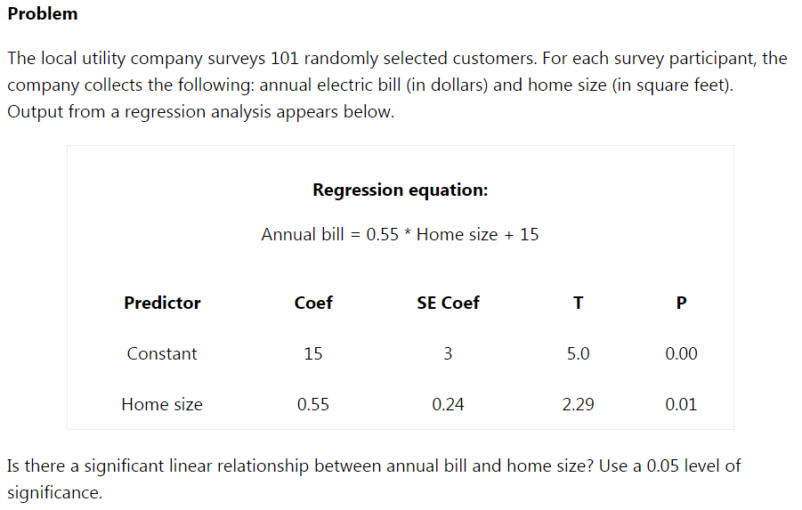
Once you have the line equation you can test hypotheses.

Slide 15
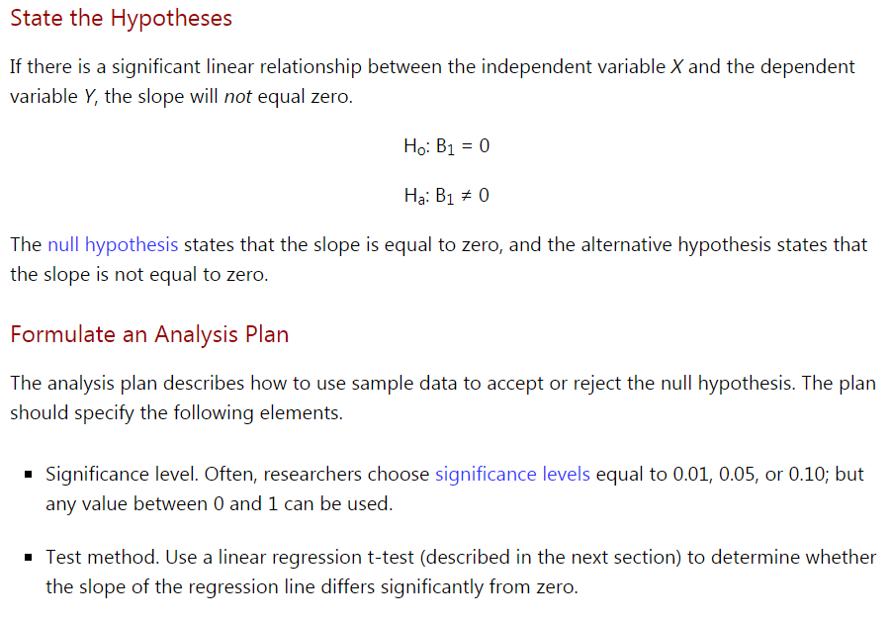

Slide 16
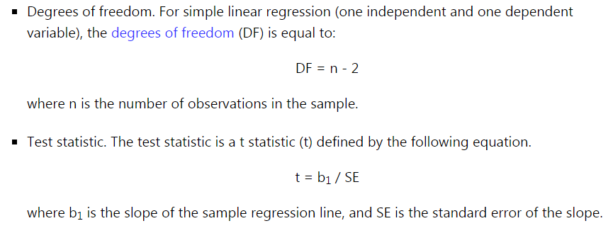

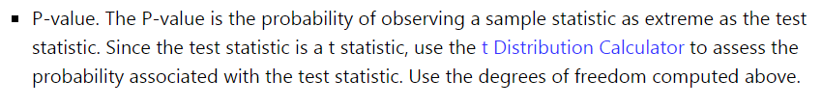

Slide 17
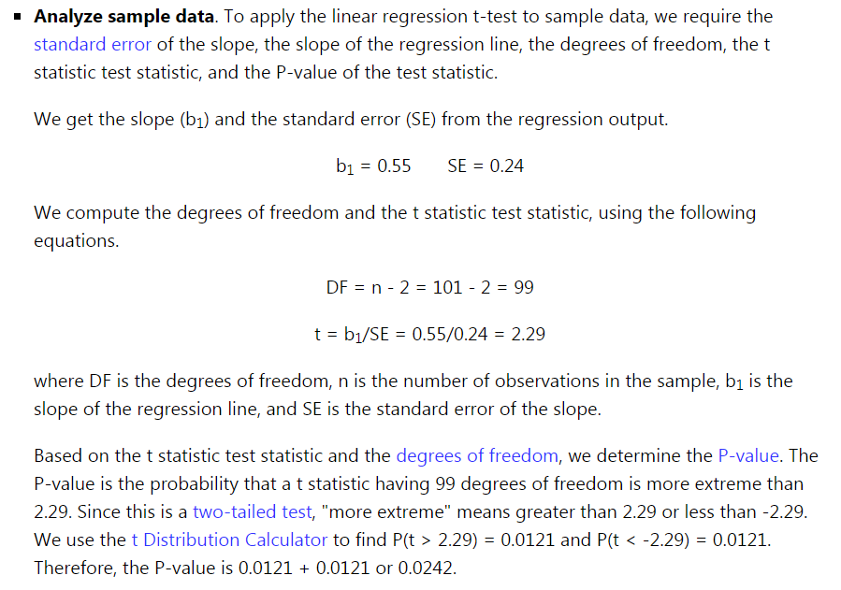

Slide 18
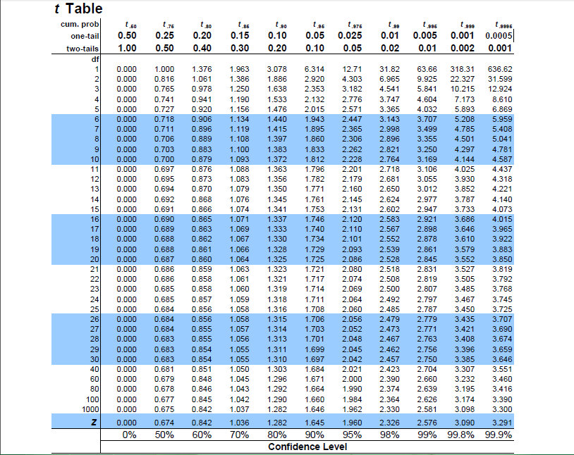

Slide 19
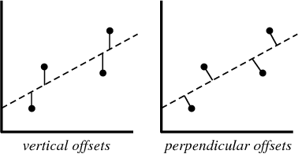
Why do regressions often have an F statistic instead of a t statistic?
Significance of regressions and ANOVAs can be examined in the same way using Model vs. Error Sums of Squares and an F-test
This is particularly useful with more complex regressions & ANOVAs, as well as ANCOVA, which combines regression and ANOVA in the same analyses

Slide 20
SS in Regression and ANOVA
Regression
F ≈ SS_{Error}/SS_{Regression}
d.f. = 1, N-1
ANOVA
F = MS_{Between}/MS_{Within}
d.f. = K-1, ΣK/N-1
y
y
x
a
b

Slide 21
Assumptions of Regression & ANOVA (and linear models in general)
Independence of observations
The occurrence of one event does not affect the probability of occurrence of other events.
Residuals are normally distributed
Residuals are the differences between observed values in a sample and the values predicted by a model.
Shapiro-Wilk test → shapiro.test() in R
Homoscedasticity, or homogeneity of variances
Basically, variance of y is consistent across all values of x.
Breusch-Pagan test → bptest() in R

Slide 22
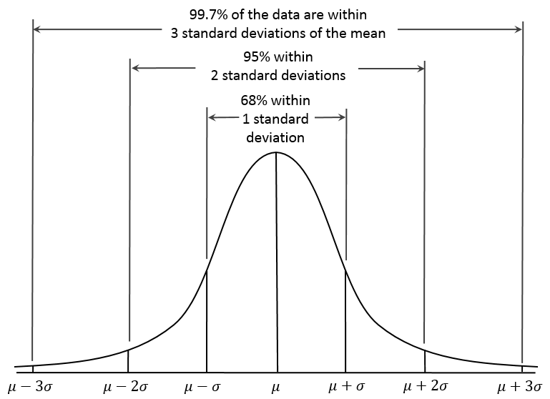

Slide 23
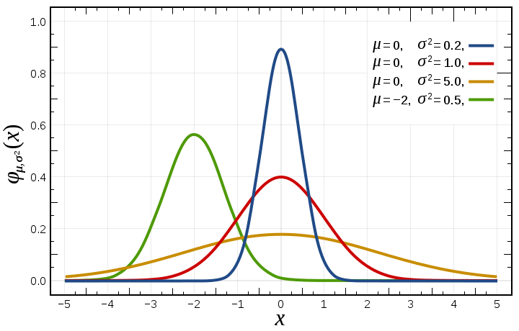
Normal distribution

Slide 24
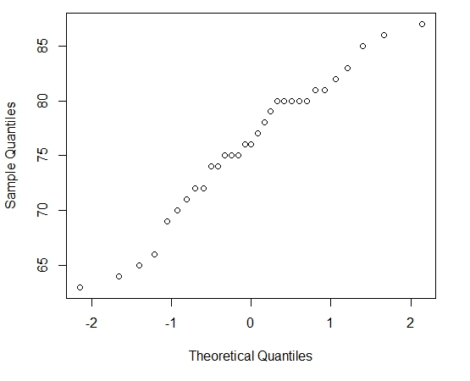
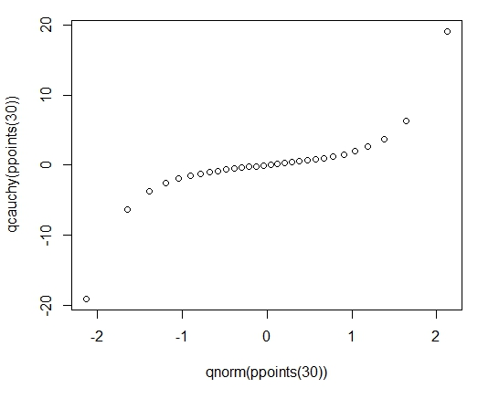
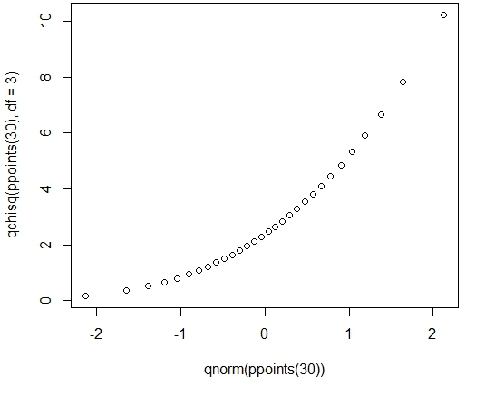
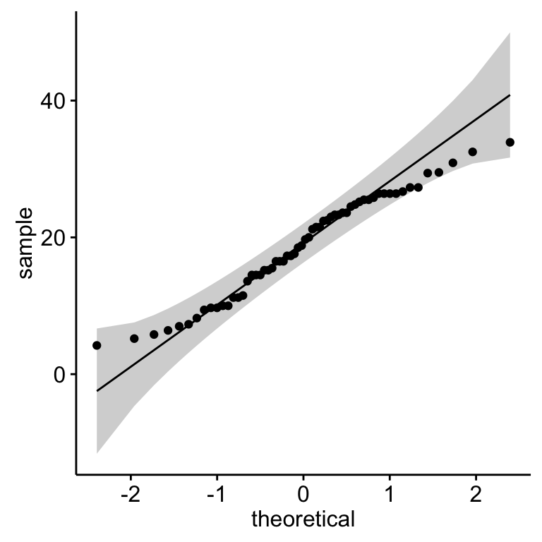
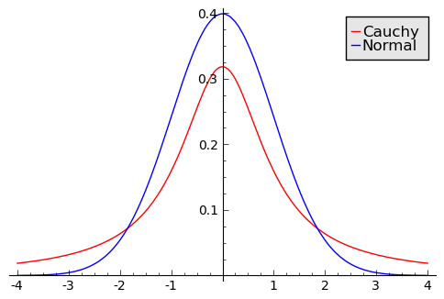
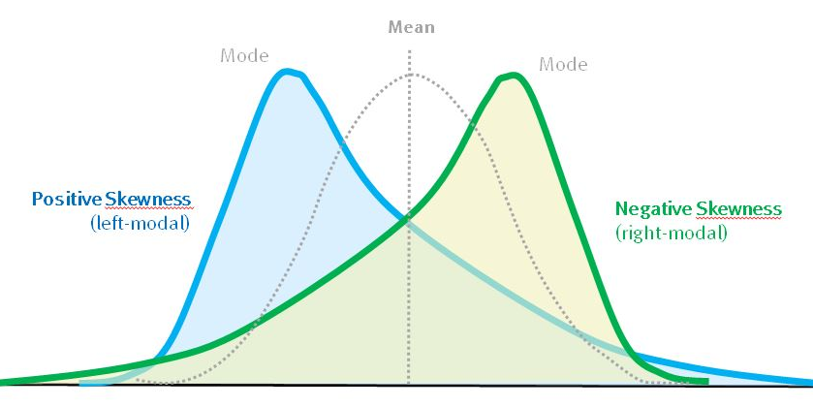
Quantile-quantile (Q-Q) plots
Normal
Not normal
Heavy tails
Skewed

Slide 25
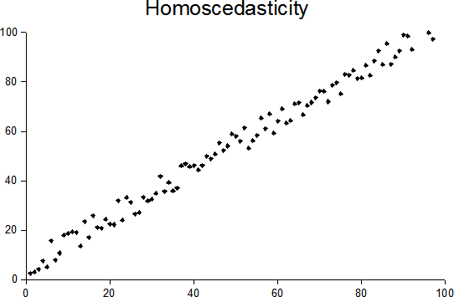
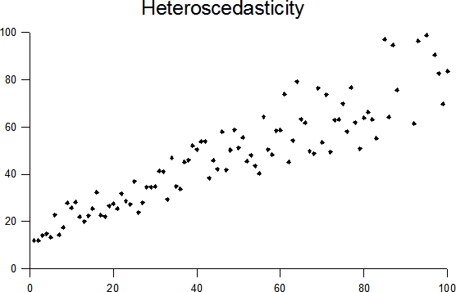
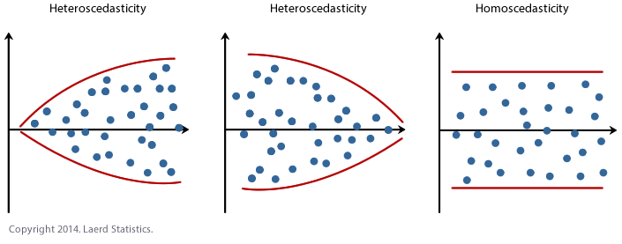
Values
Residuals

Slide 26
ANOVA (Analysis Of Variance)

Slide 27
ANOVA
Also a linear model approach, but using categorical predictors
Premise
Students were asked to recall from memory as many words as they could from a list given to them previously.
The investigator wanted to know if the type/nature of the words on the list influenced how many words were recalled.
Null hypothesis
Means within categories are all equal.
Test statistic = F ratio
MS_{B} / MS_{W}
(Error between or among groups) / (Error within groups)

Slide 28
Summary values for ANOVA

Slide 29
Data

Slide 30
Computations

Slide 34
Summary table

Slide 36
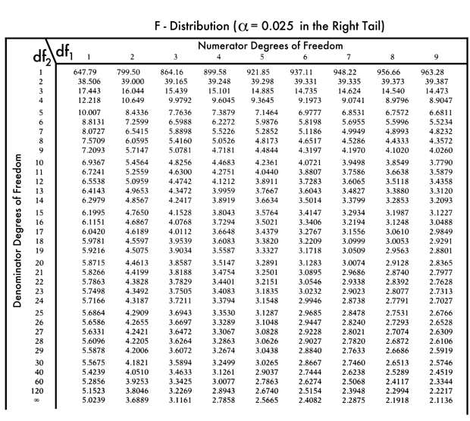

Slide 37
SS in Regression and ANOVA
Regression
F ≈ SS_{Error}/SS_{Regression}
d.f. = 1, N-1
ANOVA
F = MS_{Between}/MS_{Within}
d.f. = K-1, ΣK/N-1
y
y
x
a
b

Slide 38
Logistic Regression

Slide 39
Deceptively complex
It may seem that logistic regression would be simpler than ordinary regression because the response variable is binary, but the opposite is true.
Actually one of the simplest forms of a generalized linear model.
Logistic regressions are typically fit using an optimization algorithm, which cannot practically be done “by hand” as we have for the prior 3 analyses.
Even the simplest form of logistic regression is very computationally intensive, we will walk through it for demonstration.

Slide 40
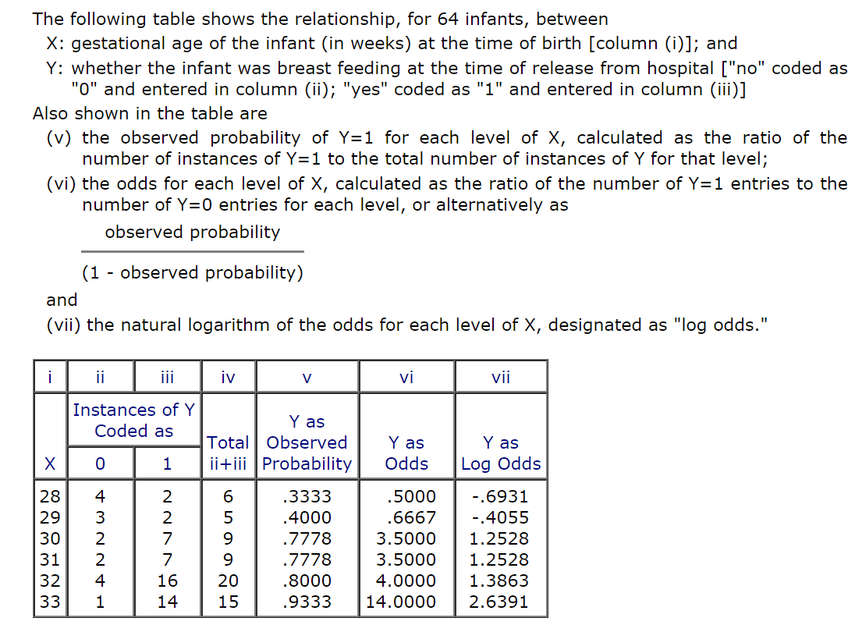

Slide 41
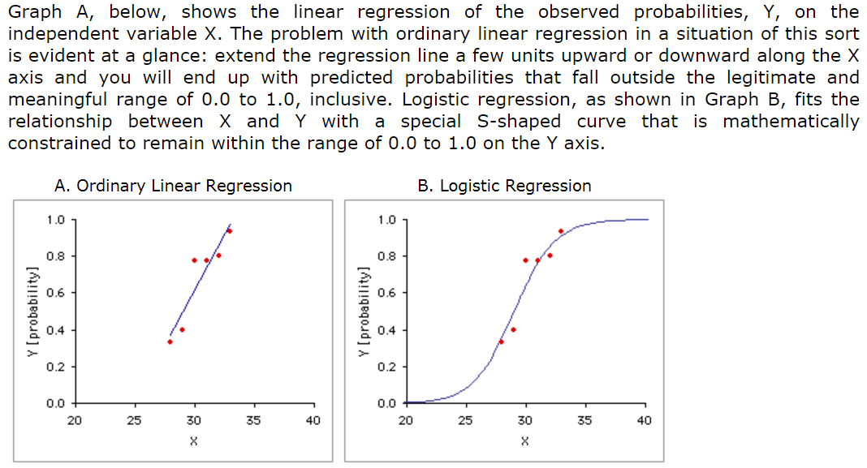

Slide 42
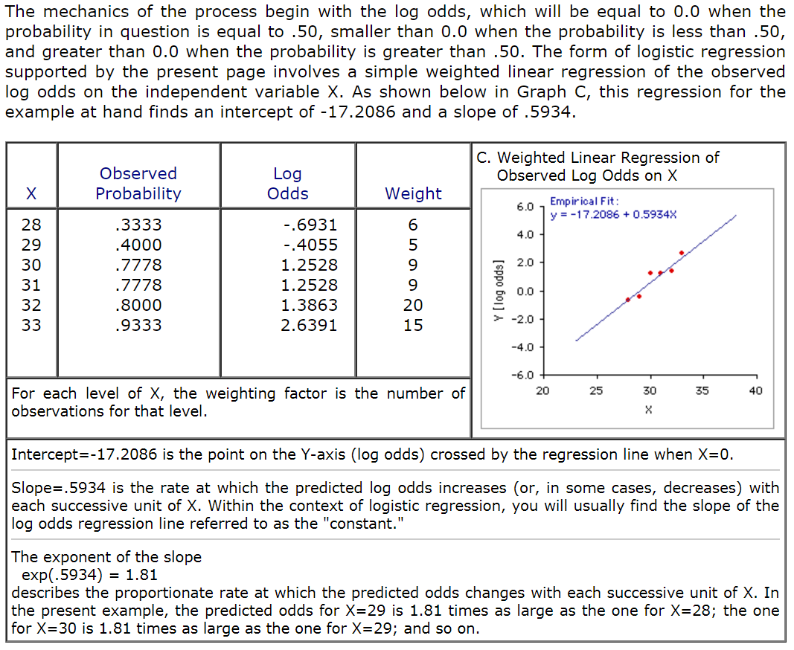

Slide 43
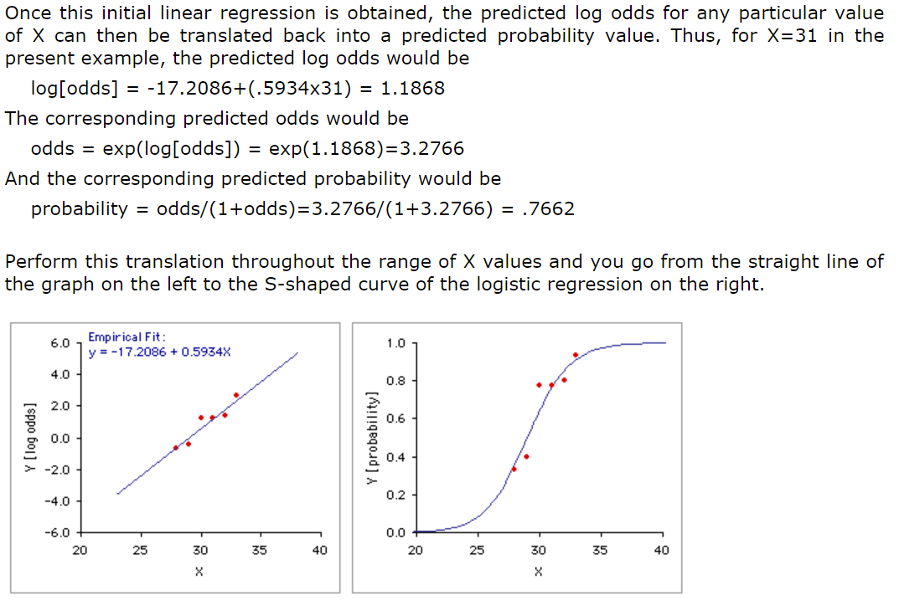

Slide 44
Linear Models
Regression
lm(y ~ continuous.factor, data)
Multiple regression
lm(y ~ continuous.factor.1 + continuous.factor.2 …, data)
ANOVA
1-way: lm(y ~ categorical.factor, data)
2-way: lm(y ~ categorical.factor.1 +/* categorical.factor.2, data)
Factorial: lm(y ~ categorical.factor.1 * categorical.factor.2 …, data)
ANCOVA
lm(y ~ continuous.factor.1 … + categorical.factor.1 …, data)
Repeated measures ANOVA/ANCOVA
Implementation in R is usually more complex. More on this later.

Slide 45
Generalized Linear Models

Slide 46
Generalized Linear Models
Next we focus on the glm() command, which allows us to fit models and perform hypothesis tests on non-normal data.
GLM refers to the generalized linear model, which is a flexible generalization of ordinary linear regression that allows response variables to have non-normal error distributions.
A key goal is to learn how to identify different types of non-normal data and to know which distribution families are appropriate for different types of data.
Another important capability of glm() is specification of random effects. More on this later.

Slide 47
Key GLM Topics
Distribution families
Link functions
Zero-inflation
Fixed vs. random effects
Bootstrapping (not GLM, an important alternative)

Slide 48
Generalized Linear Models
The core of the glm() command is the same as lm().
glm(y ~ factors, data …)
But now you also specify a distribution family
glm(y ~ factors, data, family = <name>)
<name> can = binomial, gaussian, Gamma, inverse.gaussian, poisson, quasi, quasibinomial, or quasipoisson
And sometimes a link function
glm(y ~ factors, data, family = binomial(link = “<link name>”))
Valid <link name> options depend on the distribution family
And a weighting factor for some families (e.g., binomial)
glm(y ~ factors, data, family, weights = <numeric vector>))

Slide 49
Advantages of GLMs over OLS linear models
No need to transform the response to have a normal distribution
The choice of link function is separate from the choice of distribution family, thus we have more flexibility in modeling
If the link function produces additive effects, then we do not need constant variance
Models are fitted via maximum likelihood estimation, thus the parameter estimates are considered to be better approximations of true values
Inference and model validation methods apply across most GLMs (e.g., Wald and likelihood ratio tests, deviance, residuals, confidence intervals, overdispersion)
Limitations of GLMs
Predictor variables can only have a combined linear function (“linear predictor”)
Responses must be independent
Harder to extract P values in R

Slide 50
Distribution Families in glm()
Embrace your non-normality!
binomial
Gamma
gaussian
inverse.gaussian
poisson
quasi
quasibinomial
quasipoisson

Slide 51
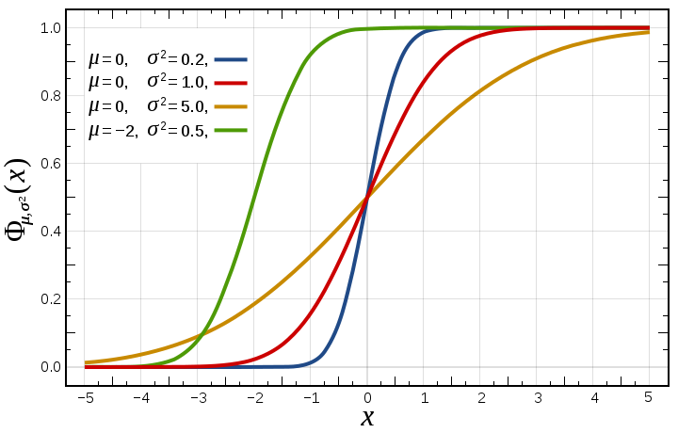
Gaussian (Normal) Distribution
The Gaussian or normal distribution is the well-known bell-shaped curve, whose only variable parameters are mean and standard deviation or variance (std dev = sqrt(variance)).
The normal distribution is useful because of the central limit theorem, which basically states that independent observations of random variables become normally distributed when the number of observations is sufficiently large.
This makes the normal distribution very useful for estimating any random variable whose distribution is not known, and it is the foundation for many statistical tests.

Slide 52
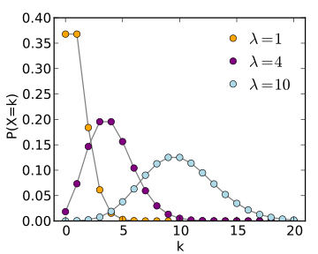
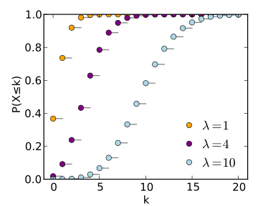
Poisson Distribution
The Poisson distribution expresses the probability of a given number of events occurring in a fixed interval of time or space if these events occur with a known constant rate and independently of the time since the last event.
The Poisson distribution can also be used for the number of events (e.g., encounters) in other specified intervals, such as distance, area, or volume.
Best option for count data (integers).
Suitable for strongly right-skewed data with long tales (much observation data is like this, e.g., counts of species in plots).

Slide 53
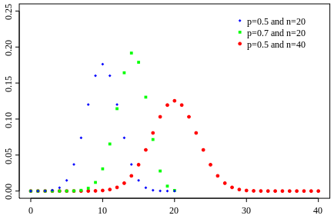
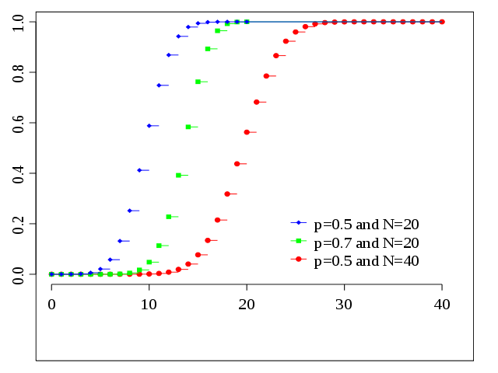
Binomial Distribution
The binomial distribution with parameters n and p is the discrete probability distribution of the number of successes in a sequence of n independent experiments, each with a binary or boolean-valued outcome: success/yes/true/one (with probability p) or failure/no/false/zero (with probability q = 1 − p).
Works for any binary response, including survival.
Even works with proportions of p (e.g., percent survival), but this needs to be weighted by the group size (e.g., 20% survival with 10 vs. 100 samples).

Slide 54
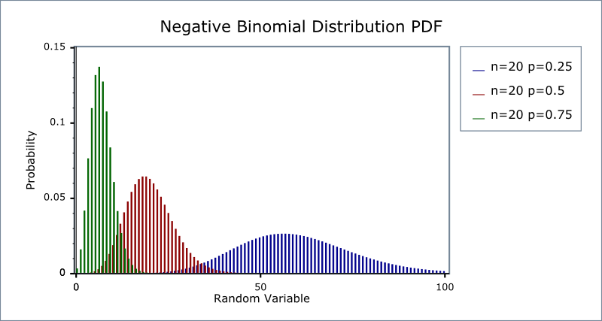
Negative Binomial Distribution
The negative binomial distribution is a discrete probability distribution of the number of successes in a sequence of independent and identically distributed Bernoulli trials before a specified (non-random) number of failures (denoted r) occurs.
For example, if we define a 1 as failure, all non-1s as successes, and we throw a dice repeatedly until 1 appears the third time (r = three failures), then the probability distribution of the number of non-1s that appeared will be a negative binomial distribution.
Often used for zero-inflated data.
Often used for over-dispersed count data.
Can often be appropriately applied to most binary data.

Slide 55
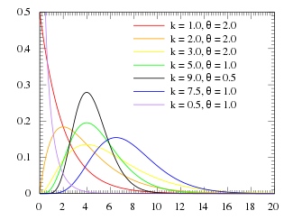
Gamma Distribution
The gamma distribution is a two-parameter family of continuous probability distributions. The exponential distribution, Erlang distribution, and chi-squared distribution are special cases of the gamma distribution.
Gamma distribution is a distribution that arises naturally in processes for which the waiting times between events are relevant. It can be thought of as a waiting time between Poisson distributed events (e.g., rainfall events).
Usually good for data following exponential, rather than linear patterns (if not transformed).
Often suitable for data that are continuous, positive, right-skewed and where variance is near-constant on the log-scale.
Gamma + Poisson = negative binomial

Slide 56
Link Functions
Valid link functions in R depend on the distribution family
gaussian accepts “identity”, “log”, and “inverse”
binomial accepts “logit”, “probit”, “cauchit”, “log”, and “cloglog”
First 3 corresponding to logistic, normal, and Cauchy cumulative distribution functions
cloglog is the complementary log-log function
Gamma accepts “inverse”, “identity”, and “log”
poisson accepts “log”, “identity”, and “sqrt”
inverse.gaussian accepts “1/mu^2”, “inverse”, “identity”, and “log”
quasi accepts “logit”, “probit”, “cloglog”, “identity”, “inverse”, “log”, “1/mu^2”, and “sqrt”

Slide 57
Which link function to use?
Usually fine to stick with R’s default link function (to not specify one).
Exceptions:
Logistic regressions use binomial(link = “logit”)
Usually use “log” link with negative binomial PDF

Slide 58
Zero-inflation
Natural data is often zero-heavy.
This is particularly true with count data, as well as occurrence data for events that are relatively rare.
General approaches to zero-heavy data:
Analyze it first as a binary value (yes/present/live or no/absent/dead), then use linear models for occurrences where yes/present/live
Zero-inflated Poisson regression (ZIP)
Zero-inflated negative binomial regression (if data are also overdispersed, e.g., variance is greater than mean)
Bootstrapping

Slide 59
Zero-inflated Poisson regression
Test for zero-inflation by examining data structure and with zero.test() command in the vcdExtra package.
Theory suggests that excess zeroes are generated by a separate process from the count values and excess zeroes can be modeled independently
ZIP models have two parts:
A Poisson count model
A logit model (logistic regression) for predicting excess zeroes

Slide 60
Zero-inflated Negative Binomial Regression
https://stats.idre.ucla.edu/r/dae/zinb/

Slide 61
Over-dispersion
Greater variability than would be expected for a given distribution family.
In Poisson models, the mean should equal the variance
Overdispersed Poisson models will generate understated standard errors
Real confidence intervals should be larger than calculated
This can lead to Type II errors

Slide 62
Fixed and random effects models

Slide 63
Fixed vs. Random Effects
Fixed effects models and random effects models ask different questions of the data.
Fixed effect models create group-level variables that control for all unobserved heterogeneity in the group-level average response, thus model estimates reflect only variability within units.
Random effects models start with the assumption that there is a larger population of many groups/sites/factor levels, and that your sample reflects draws from that population. So rather than anchoring estimates around observed group values, your data are used to elucidate the parameters of the larger population from which your data were supposedly drawn.
It is often said that fixed effects models are good for conducting inference on the data that you have, and that random effects models are good for trying to conduct inference on some larger population from which your data is a random sample.

Slide 64
Example: Fixed vs. random effects
Suppose m large elementary schools are chosen randomly from among thousands in a large country. Suppose also that n pupils of the same age are chosen randomly at each selected school. Their scores on a standardized test are ascertained.
Let Y_{ij} be the score of the j^{th} pupil at the i^{th} school. μ is the average test score for the entire population. A simple way to model the relationships of these quantities is
Y_{ij} = μ + U_{i} + W_{ij}
U_{i} is the school-specific random effect: it measures the difference between the average score at school i and the average score in the entire country.
W_{ij} is the individual-specific random effect: it is the deviation of the j^{th} pupil’s score from the average for the i^{th} school.

Slide 65
The model can be augmented by including additional explanatory variables with slopes of β, which would capture differences in scores among different groups.
Y_{ij} = μ + β₁Sex_{ij} + β₂Race_{ij} + β₃ParentsEduc_{ij} + U_{i} + W_{ij}
Here, Sex_{ij} is the dummy variable for the pupil’s gender, Race_{ij} is the dummy variable for their race, and ParentsEduc_{ij} is the average education level of a child’s parents.
This is a mixed model, because it includes the random effects of school and individual, plus the fixed effects of Sex, Race, and Parents' Education.

Slide 66
Mixed Effects Models
Mixed models have both fixed and random effects
Usually the case when investigating random effects
Package ‘lme4’ in R (Linear Mixed-Effect Models)
lmer() used for linear models with random effects
Model formulae differ from lm() by including a term in the form of (a | b), where ‘a’ is a model matrix (often just 1) specifying the scope of the random effect, and ‘b’ is the group to which the random effect applies.
glmer() used for generalized linear models (non-normal distributions) with random effects

Slide 67
Mixed model example

